Slide 1
Seeing the Unseeable
The Mathematics of Inverse Problems
Kurt Bryan
Rose-Hulman Institute of Technology
(On leave to the U.S. Air Force Academy, 2010-2011)

Slide 2
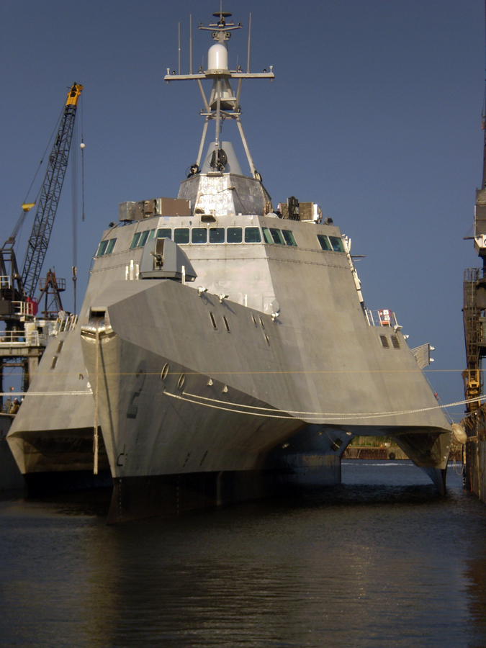
Nondestructive Testing
The USS Independence
New hull design, aluminum
Small cracks are a serious problem
How would you find such cracks?

Slide 3
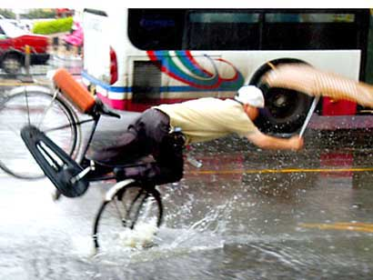
Medical Imaging
A patient comes in with altered consciousness after a bicycle accident:
How can you tell if he’s suffered a serious head injury?

Slide 4
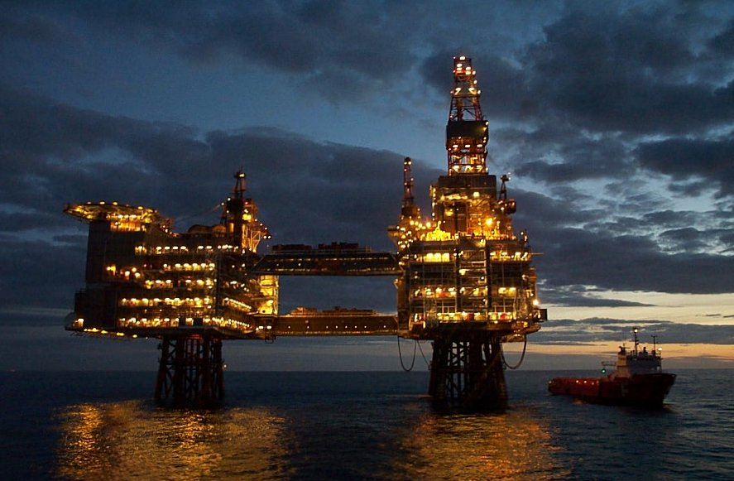
Oil Drilling
A well is drilled offshore, at a cost of $100,000,000:
How does anyone know there’s actually oil down there?

Slide 5
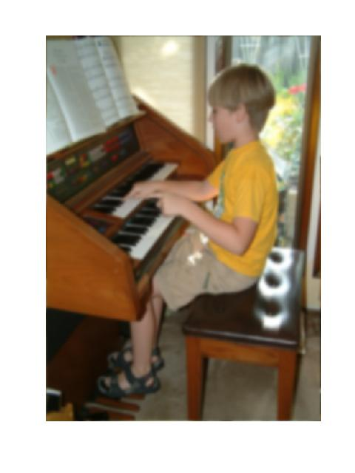
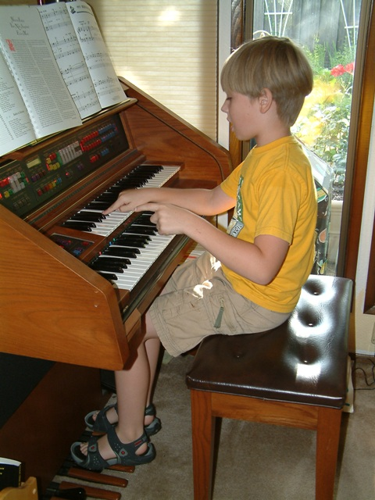
Image Processing
How does Photoshop fix out-of-focus images?

Slide 6
A Common Theme
What do all these situations have in common?

Slide 7
A Common Theme
What do all these situations have in common?
They require us to deduce underlying structure from indirect, distorted, or noisy observations.

Slide 8
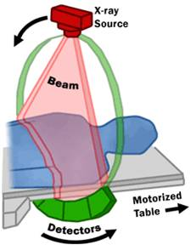
CT Scanners
First practical scanners developed in the late 1960’s
Reconstruct a 2D “slice” through the patient by using x-rays at many angles and positions

Slide 9
CT Scanners
First practical scanners developed in the late 1960’s
Reconstruct a 2D “slice” through the patient by using x-rays at many angles and positions
Given x-rays from many angles and positions, how do we construct an image?

Slide 10
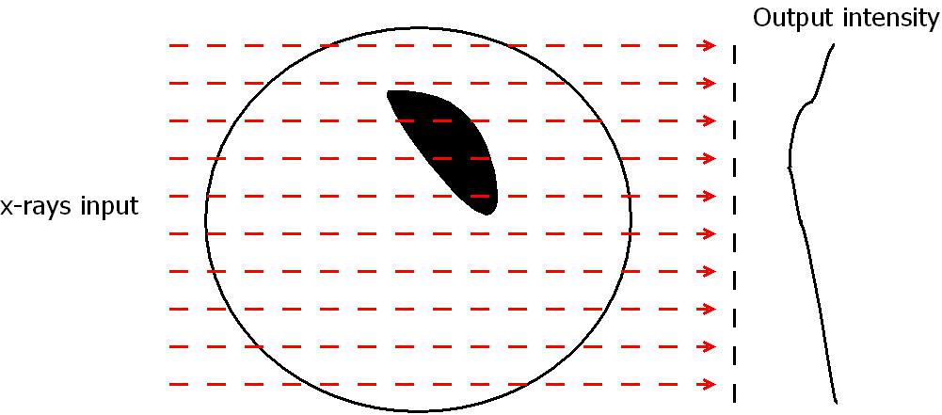
CT Procedure
We fire x-rays through at many angles and offsets:

Slide 11
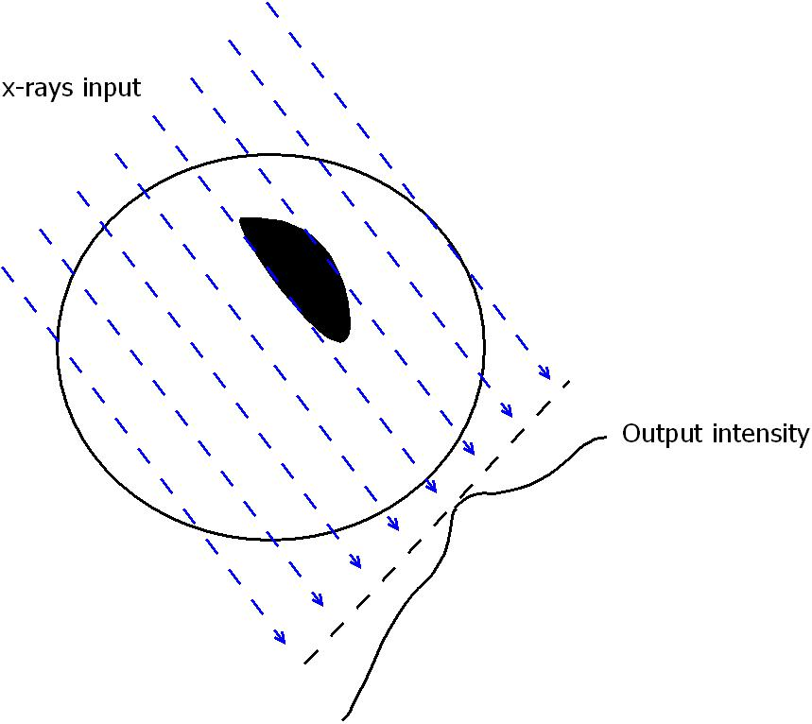
CT Procedure
We fire x-rays through at many angles and offsets:

Slide 12
CT Procedure
We fire x-rays through at many angles and offsets:
How do we put all this data together
to form an image?

Slide 13
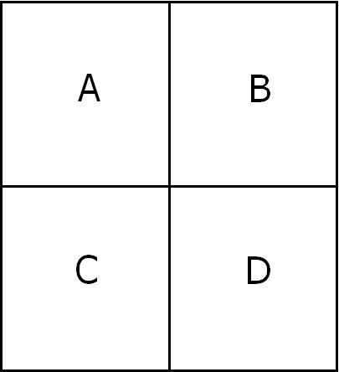
Algebraic CT Reconstruction
Consider forming a 4 pixel image:
We want to compute the “densities” A,B,C,D of each pixel.

Slide 14
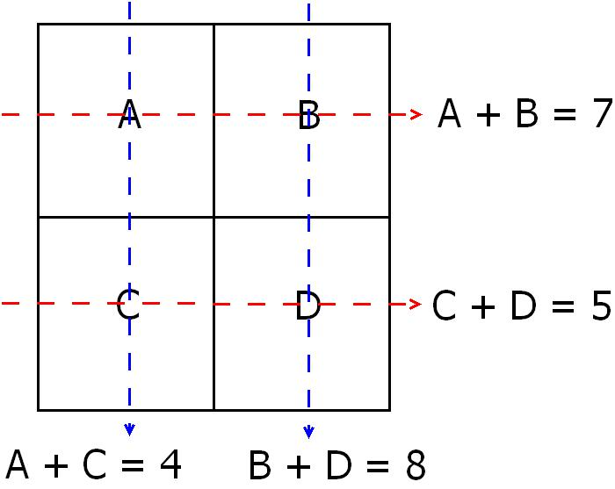
CT Reconstruction
After a bit of algebra, it comes down to finding A,B,C,D from equations like

Slide 15

CT Reconstruction
We solve 4 equations in 4 unknowns to find
A = 3, B = 4, C = 1, D = 4,
and form an image. Here 1 = darkest, 4 = lightest.
A
B
C
D

Slide 16

CT Reconstruction
For more resolution we make a finer grid:
Now we have 100 variables---but horizontal and vertical x-rays
only give us 20 equations! We need to use more angles.

Slide 17
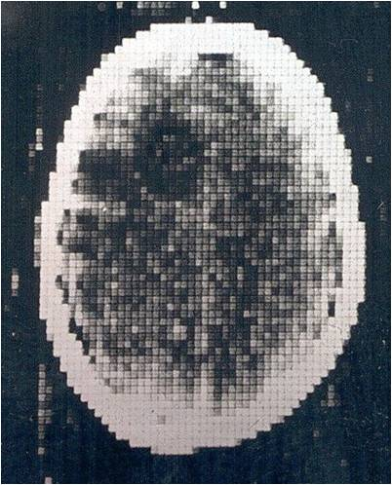
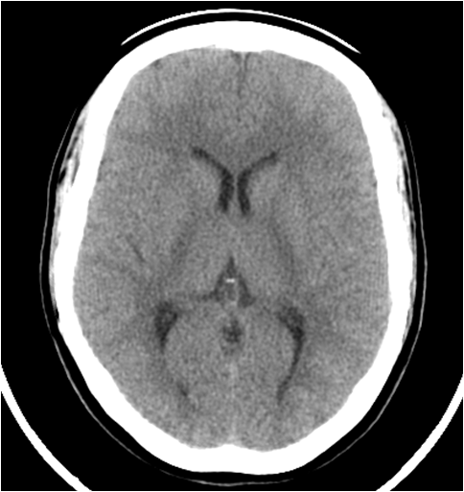
CT Reconstruction
The first CT scans were crude; modern scanners have very high resolution:
1968
2005

Slide 18
CT Reconstruction
A 1000 by 1000 pixel image would require solving for 1,000,000 variables using (at least) 1,000,000 equations!
But this is entirely possible with modern computers and the right algorithms.

Slide 19
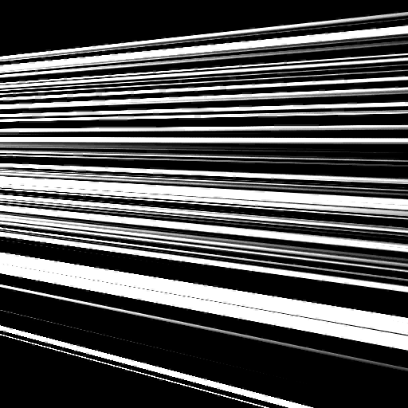
CT Animation

Slide 20
Inverse Problems
A CT scan is a good example of an inverse problem. We have

Slide 21
Inverse Problems
A CT scan is a good example of an inverse problem. We have
A physical system with unknown internal structure (the body)

Slide 22
Inverse Problems
A CT scan is a good example of an inverse problem. We have
A physical system with unknown internal structure (the body)
We “stimulate” the system by putting in some form of energy (x-rays)

Slide 23
Inverse Problems
A CT scan is a good example of an inverse problem. We have
A physical system with unknown internal structure (the body)
We “stimulate” the system by putting in some form of energy (x-rays)
We observe the response of the system (how the x-rays are attenuated)

Slide 24
Inverse Problems
A CT scan is a good example of an inverse problem. We have
A physical system with unknown internal structure (the body)
We “stimulate” the system by putting in some form of energy (x-rays)
We observe the response of the system (how the x-rays are attenuated)
From this information we determine the unknown structure

Slide 25
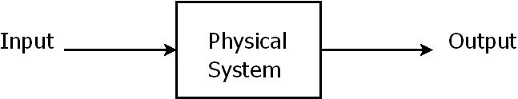
Types of Inverse Problems
Problem Type | Input | System | Output
Forward | Known | Known | ?????
Inverse | Known | ????? | Output
Inverse | ????? | Known | Known

Slide 26
Inverse Problem Issues
Mathematicians ask three questions about an inverse problem:

Slide 27
Inverse Problem Issues
Mathematicians ask three questions about an inverse problem:
Is the observed data enough to determine the unknown? For example, the single equation x + y = 4 is not enough information to find x and y.

Slide 28
Inverse Problem Issues
Mathematicians ask three questions about an inverse problem:
Is the observed data enough to determine the unknown? For example, the single equation x + y = 4 is not enough information to find x and y.
Can we find an efficient algorithm for computing the unknown from the observed data?

Slide 29
Inverse Problem Issues
Mathematicians ask three questions about an inverse problem:
Is the observed data enough to determine the unknown? For example, the single equation x + y = 4 is not enough information to find x and y.
Can we find an efficient algorithm for computing the unknown from the observed data?
How does noisy data affect the process? Will a small amount of noise ruin our ability to determine the unknown?

Slide 30
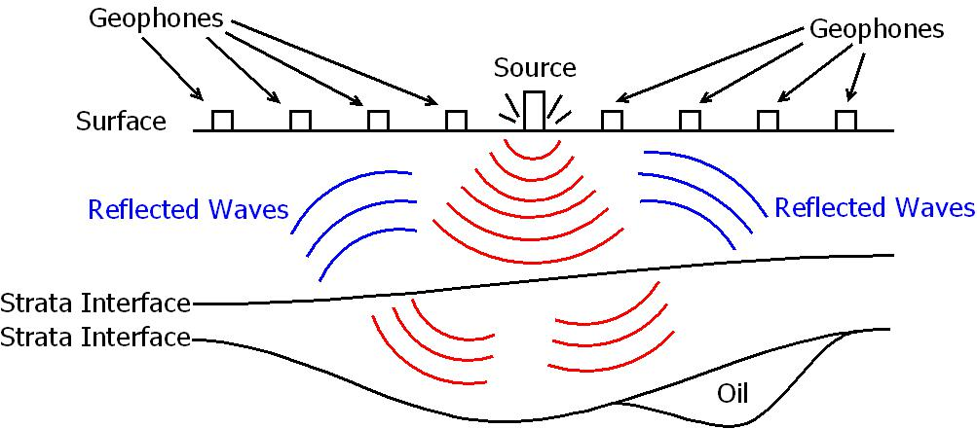
Reflection Seismology
We seek an image of subsurface structure by applying energy to the earth’s surface and measuring the resulting vibrations:

Slide 31
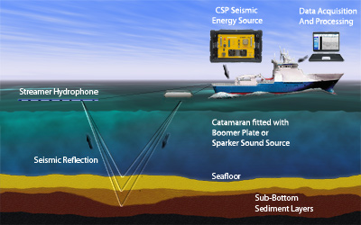
Relection Seismology
The same procedure can be done for imaging at sea:

Slide 32
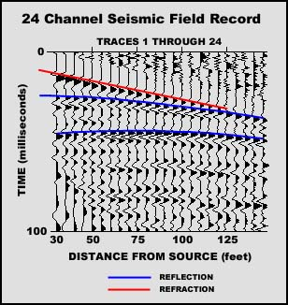
Reflection Seismogram
A graphical display of a typical data set:

Slide 33
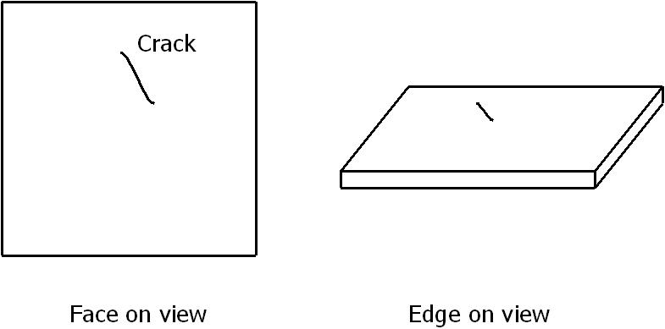
Nondestructive Testing
We want to find a small flaw (crack) in an aluminum plate. The flaw may not be visually obvious.

Slide 34
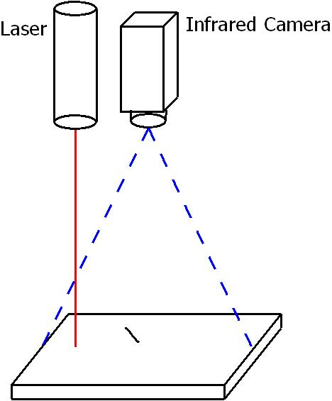
Nondestructive Testing
Experimental setup:
Pump in laser energy (heat source)
IR camera observes plate temperature
Presence of crack influences the flow of heat (we hope)
Based on what we see, find the crack

Slide 35
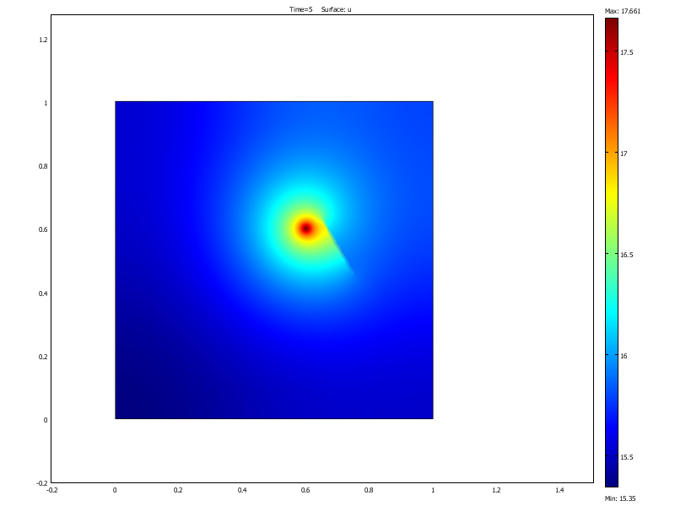
Nondestructive Testing
Big cracks are easy to see…

Slide 36
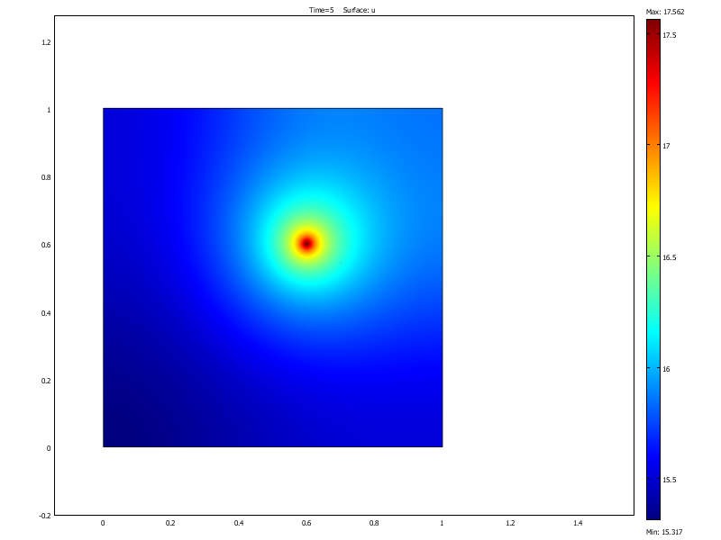
Nondestructive Testing
But small ones are not!

Slide 37
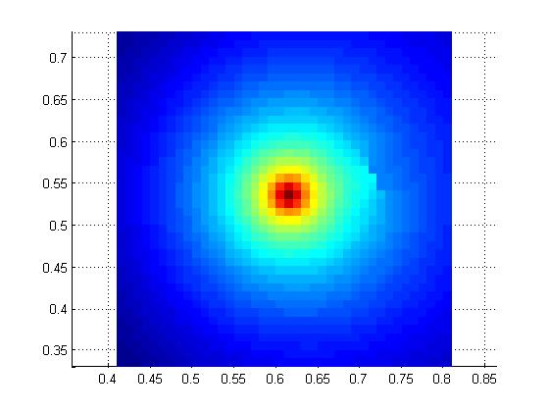
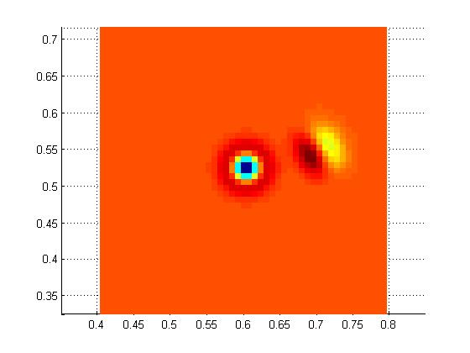
Nondestructive Testing
Understanding heat conduction along with the right image enhancement techniques can help:
Plate temperature at time t = 10
Enhanced image---crack very visible

Slide 38
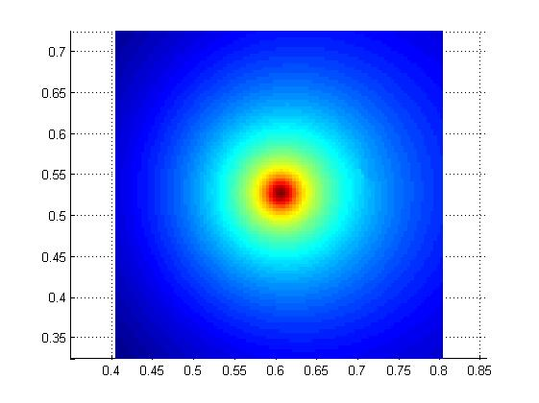
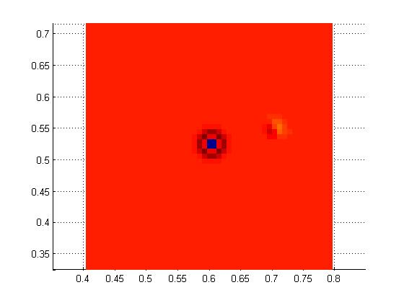
Nondestructive Testing
Understanding heat conduction along with the right image enhancement techniques can help:
Plate temperature at time t = 10
Enhanced image---crack very visible

Slide 39
Image Processing
A beloved family photo is
out of focus:
Can we fix it?

Slide 40

Image Sharpening
This is a type of inverse problem:
We have the blurry image and can mathematically model
an out-of-focus camera. From this, we try to back out the
“true” real world image.

Slide 41
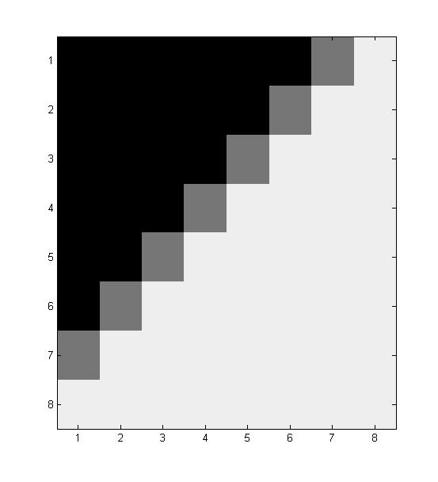
A Simple Model of Blurring
Consider a black and white image. Each pixel has a value from 0 (black) to 255 (white). A typical 8 by 8 block might look like

Slide 42
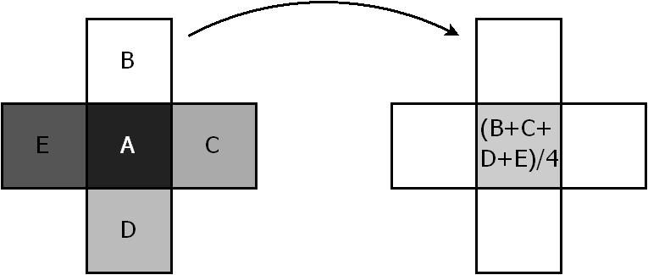
A Simple Model of Blurring
One model of blurring: each pixel is replaced by the average of its 4 nearest neighbors. This blurs adjoining pixels together, brings down highs, brings up lows, softens edges:
Sharp Image
Blurred Image

Slide 43
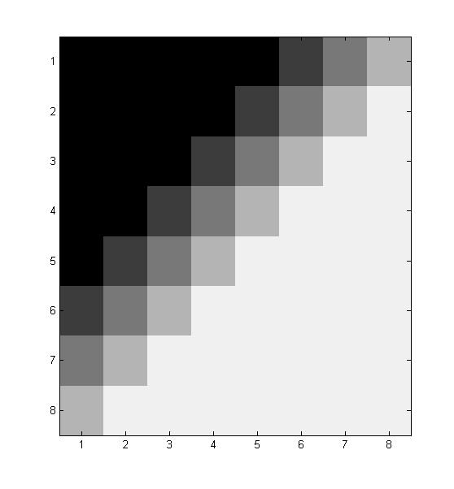
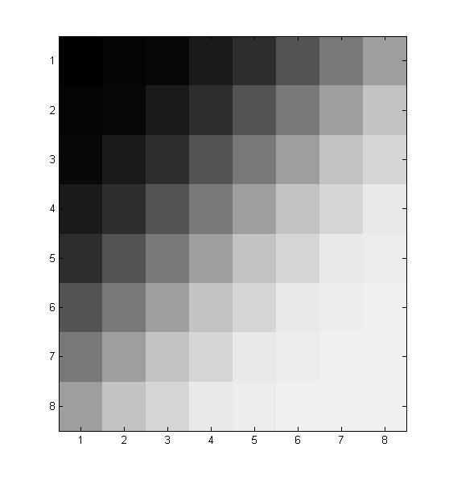
A Simple Model of Blurring
The original block, blurred once, and blurred 5 times:
Original
Blurred once
Blurred five times

Slide 44
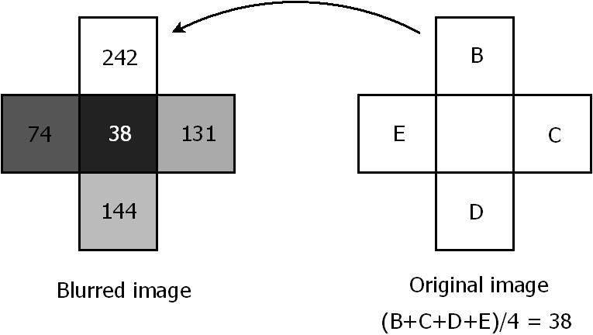
Fixing a Blurred Image
We need to “un-blur” the image. In the original image we know that (B+C+D+E)/4 = 38. We need to solve for B, C, D, E.

Slide 45
Fixing a Blurred Image
We get an equation like (B+C+D+E)/4 = 38 for every pixel in the image, and all the equations are coupled together.
For a 640 x 480 black and white picture that’s a system of 307,200 equations in 307,200 unknowns. For a color image, three times that many!

Slide 46
Fixing a Blurred Image
We get an equation like (B+C+D+E)/4 = 38 for every pixel in the image, and all the equations are coupled together.
For a 640 x 480 black and white picture that’s a system of 307,200 equations in 307,200 unknowns. For a color image, three times that many!
But there are clever ways to solve systems this large, in just seconds…

Slide 47

Image Sharpening Example
Blurry image and once-sharpened image

Slide 48

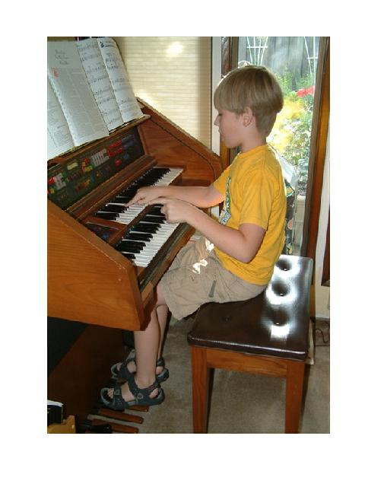
Image Sharpening Example
Image sharpened five (left) and ten (right) times

Slide 49
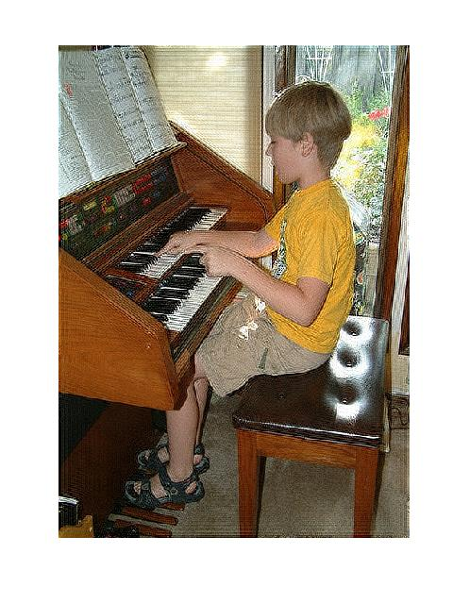
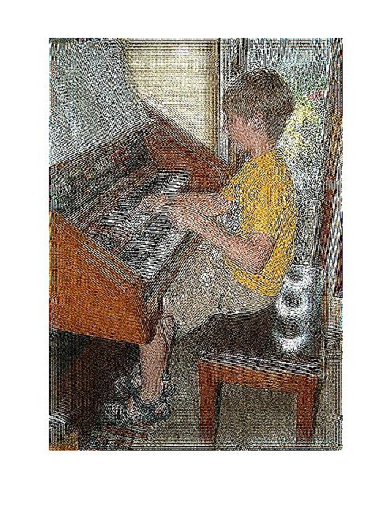
Image Sharpening Example
Image sharpened eleven (left) and twelve (right) times

Slide 50
A Variation on Inverse Problems
Suppose you want to sneak some contraband across the border, hidden in your car.
Who would you ask for advice on how best to hide it?

Slide 51
A Variation on Inverse Problems
Suppose you want to sneak some contraband across the border, hidden in your car.
Who would you ask for advice on how best to hide it?
Answer: the people whose job it is to find contraband---a border patrol agent!

Slide 52
Hiding Stuff
Suppose you want to make something hard to find using any of the techniques we’ve discussed (or any other imaging methodology).
Who would you ask for advice on how to hide it?

Slide 53
Hiding Stuff
Suppose you want to make something hard to find using any of the techniques we’ve discussed (or any other imaging methodology).
Who would you ask for advice on how to hide it?
Answer: the people who specialize in finding things with these imaging techniques---the mathematicians!

Slide 54
Cloaking and Invisibility
There’s recently been much progress in the mathematics and physics community on cloaking---making things invisible!
The key is to use the principles of inverse problems and ask “what would make objects hard to find?”
One approach is to surround an object with a “metamaterial,” a cleverly designed substance that bends energy around the object to be hidden.

Slide 55
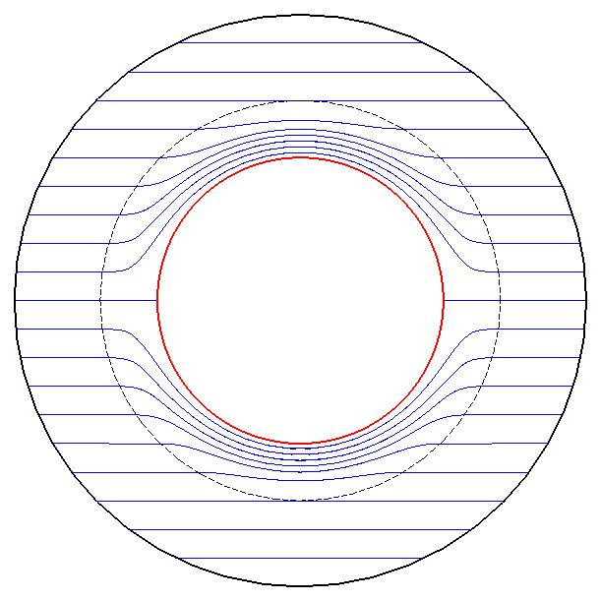
Cloaking Example
The metamaterial bends the energy around the hole, as if the hole isn’t even there!
Cloaked object
Metamaterial

Slide 56
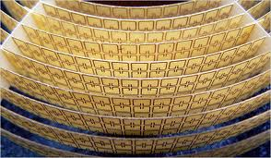
Cloaking
People are working on real cloaking devices

Slide 57
The Mathematics of Inverse Problems
The essential types of mathematics needed to explore inverse problems are
Linear Algebra---the study of large systems of linear equations
Calculus and differential equations---this describes most physical phenomena that involve change or the flow of energy
Numerical analysis---the study of how to use computers to solve large-scale problems efficiently and accurately

